Slide 1


Damped Oscillation: When the motion of an oscillator is reduced by an external force, the oscillator and its motion are said to be damped.
Damped force exerted by the liquid, $F_{d}=−bv$
$$where b is the damping constant and v is$$
$the$ $velocity of the block and the vane.$
$$Spring force, F_{s}=−Kx$$
Let us assume that the gravitational force on the block is negligible relative to Fd and Fs.

Slide 2


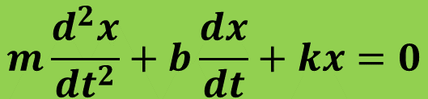


From Newton’s second law
$$F_{net}=ma$$
$$F_{d}+F_{s}=ma$$
$$−bv−Kx=ma$$
$$ma+bv+Kx=0$$
$$m\frac{d^{2}x}{dt^{2}}+b\frac{dx}{dt}+kx=0$$
This is the equation for damped oscillation.

Slide 3
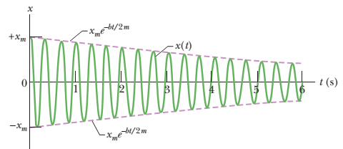
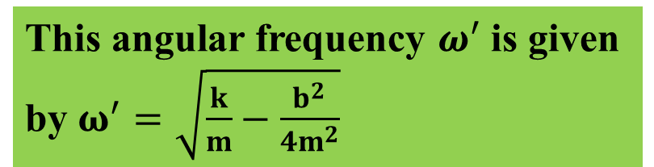
The solution of this equation is, $x\left(t\right)=x_{m}e^{−\frac{bt}{2m}} cos (ω^{′}t+φ)$
$x\left(t\right)$ is the displacement of the damped motion after time t.
where ${(x}_{m}e^{−\frac{bt}{2m}})$is the amplitude which decreases exponentially with time.
This angular frequency $ω^{′}$is given by $ω^{′}=\sqrt{\frac{k}{m}−\frac{b^{2}}{4m^{2}}}$

Slide 4
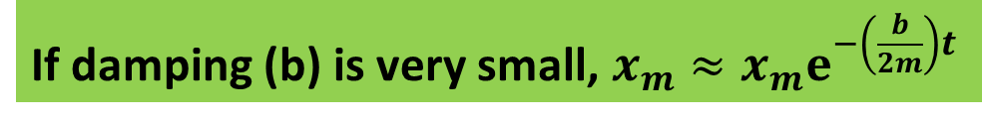

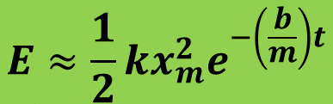
Damped $mechanical energy:$
$The mechanical energy for an undamped oscillator$is constant$, E=\frac{1}{2}kx_{m}^{2}$
If damping (b) is very small, ${x_{m}≈x}_{m}ⅇ^{−\left(\frac{b}{2m}\right)t}$
$$The mechanical energy for a damped oscillator, E≈\frac{1}{2}k{\left\{x_{m}ⅇ^{−\left(\frac{b}{2m}\right)t}\right\}}^{2}$$
$$E≈\frac{1}{2}kx_{m}^{2}ⅇ^{−\left(\frac{b}{m}\right)t}$$
$$The mechanical energy for a damped oscillator decreases$$
$$as a function of time$$

Slide 5
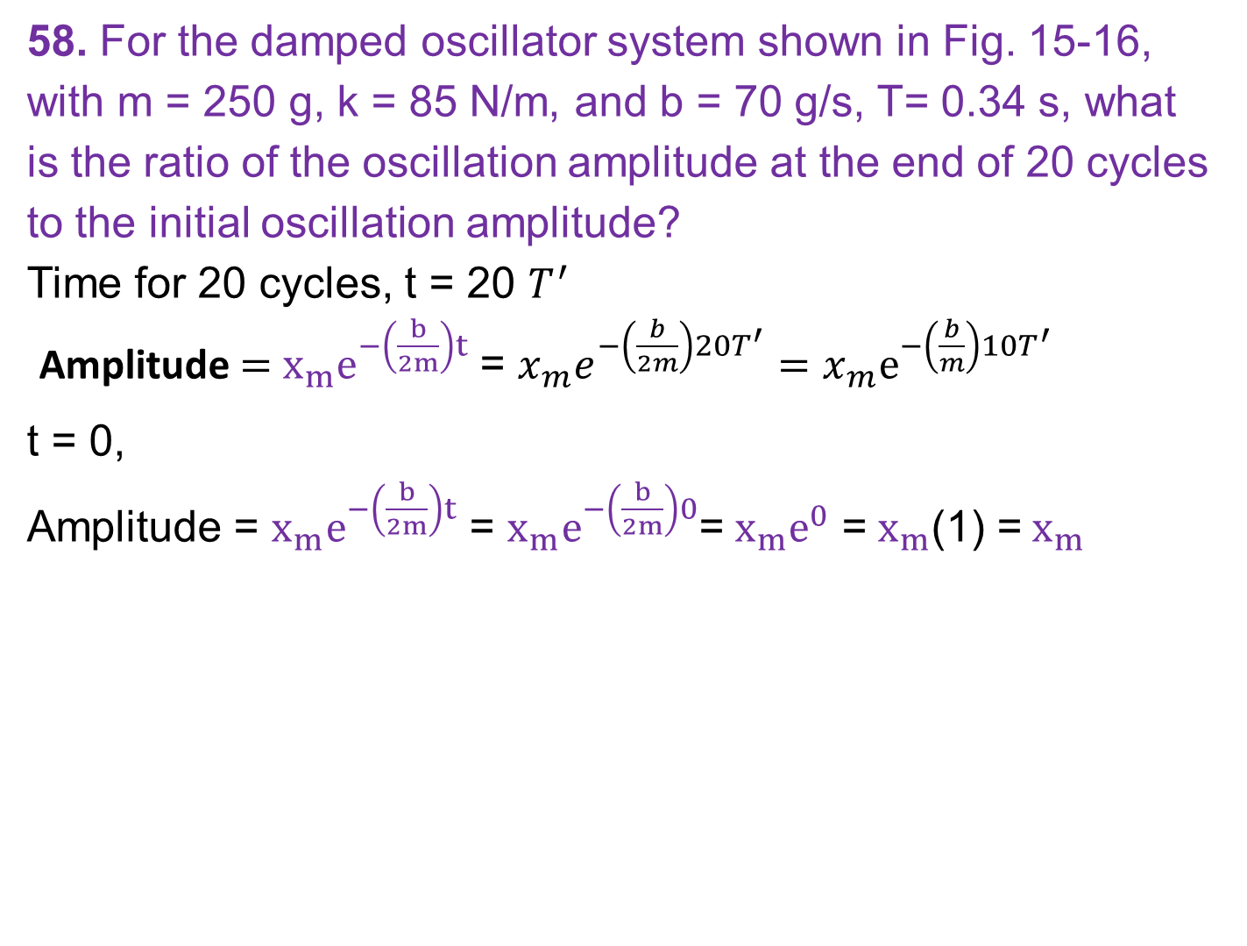
58. For the damped oscillator system shown in Fig. 15-16, with m = 250 g, k = 85 N/m, and b = 70 g/s, T= 0.34 s, what is the ratio of the oscillation amplitude at the end of 20 cycles to the initial oscillation amplitude?
Time for 20 cycles, t = 20 $T^{′}$
Amplitude $=$ $x_{m}ⅇ^{−\left(\frac{b}{2m}\right)t}$ = $x_{m}ⅇ^{−\left(\frac{b}{2m}\right)20T^{′}}=x_{m}ⅇ^{−\left(\frac{b}{m}\right)10T^{′}}$
t = 0,
Amplitude = $x_{m}ⅇ^{−\left(\frac{b}{2m}\right)t}$ = $x_{m}ⅇ^{−\left(\frac{b}{2m}\right)0}$= $x_{m}ⅇ^{0}$ = $x_{m}$(1) = $x_{m}$
m = 250 g= 0.250 kg
k = 85 N/m
b = 70 g/s = 0.070 kg/s
T= 0.34 s

Slide 6
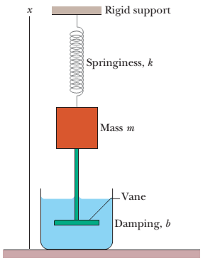

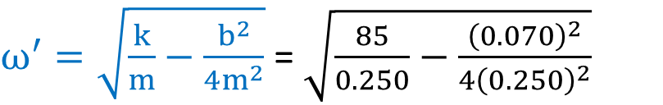
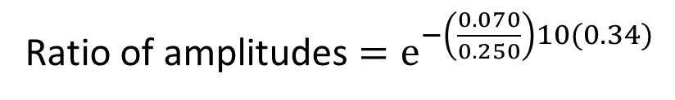

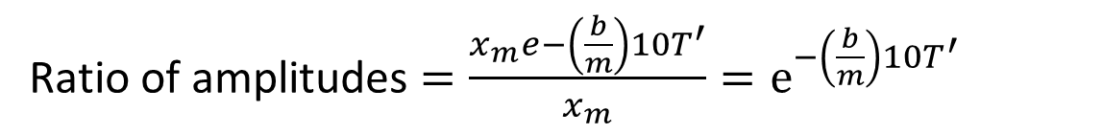

Ratio of amplitudes $=\frac{x_{m}ⅇ−\left(\frac{b}{m}\right)10T^{′}}{x_{m}}=ⅇ^{−\left(\frac{b}{m}\right)10T^{′}}$
$ω^{′}=\sqrt{\frac{k}{m}−\frac{b^{2}}{4m^{2}}}$ = $\sqrt{\frac{85}{0.250}−\frac{{\left(0.070\right)}^{2}}{4{\left(0.250\right)}^{2}}}$
F_{s}
$$ω^{′}=18.44 rad/s$$
x
$T^{′}=\frac{2π}{ω^{′}}$ = 0.34 s
rod
F_{d}
Ratio of amplitudes $=ⅇ^{−\left(\frac{0.070}{0.250}\right)10(0.34)}$
v
$=ⅇ^{−0.952}=$ 0.39

